Slide 1

CSE- 322
Software Engineering Lab
Lab : 05 Testing using Selenium
Fahad Ahmed
Lecturer, Dept. of CSE
E-mail: fahadahmed@uap-bd.edu

Slide 2
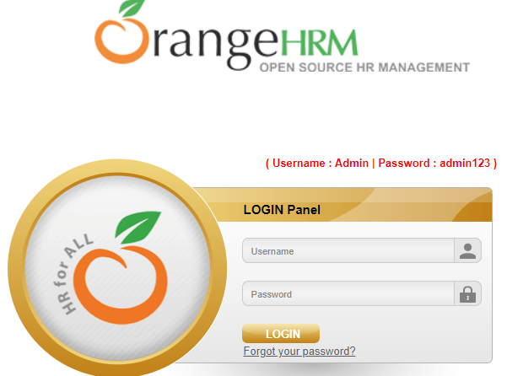
Selenium

Slide 3
Web Element In Selenium
from selenium import webdriver
from selenium.webdriver.common.by import By
import time
driver = webdriver.Chrome(executable_path="C:\\Users\\Fahad Ahmed\\PycharmProjects\\SeleniumProject01\\drivers\\chromedriver.exe")
driver.get("https://opensource-demo.orangehrmlive.com/")
print(driver.current_url)
driver.find_element(By.NAME, "txtUsername").send_keys("Admin")
print("find username field\n")
driver.find_element(By.ID, "txtPassword").send_keys("admin123")
print("find password field\n")
time.sleep(2)
driver.find_element(By.ID, "btnLogin").click()
print("find login field\n")
driver.close()

Slide 4
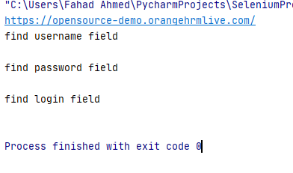
Web Element In Selenium
Output

Slide 5
Web Element In Selenium: XPATH, CSS_SELECTOR
from selenium import webdriver
from selenium.webdriver.common.by import By
import time
driver = webdriver.Chrome(executable_path="C:\\Users\\Fahad Ahmed\\PycharmProjects\\SeleniumProject01\\drivers\\chromedriver.exe")
driver.get("https://opensource-demo.orangehrmlive.com/")
print(driver.current_url)
driver.find_element(By.XPATH, "//input[@id='txtUsername']").send_keys("Admin")
print("find username field\n")
driver.find_element(By.CSS_SELECTOR,"input[type='password']").send_keys("admin123")
print("find password field\n")
time.sleep(2)
driver.find_element(By.XPATH, "//input[@value='LOGIN']").click()
print("find username field\n")
driver.close()

Slide 6
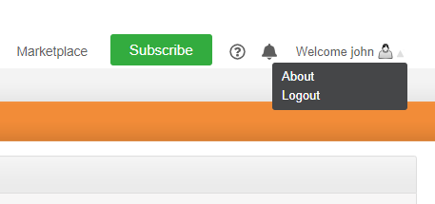
Web Element In Selenium

Slide 7
Web Element In Selenium: XPATH, CSS_SELECTOR
from selenium import webdriver
from selenium.webdriver.common.by import By
import time
driver = webdriver.Chrome(executable_path="C:\\Users\\Fahad Ahmed\\PycharmProjects\\SeleniumProject01\\drivers\\chromedriver.exe")
driver.get("https://opensource-demo.orangehrmlive.com/")
print(driver.current_url)
driver.find_element(By.XPATH, "//input[@id='txtUsername']").send_keys("Admin")
print("find username field\n")
driver.find_element(By.CSS_SELECTOR,"input[type='password']").send_keys("admin123")
print("find password field\n")
time.sleep(2)
driver.find_element(By.XPATH, "//input[@value='LOGIN']").click()
print("find username field\n")
driver.find_element(By.XPATH,"//a[contains(text(),'Welcome')]").click()
print("find welcome text \n")
time.sleep(2)
driver.find_element(By.XPATH,"//a[contains(text(),'Logout')]").click()
print("After Logout ", driver.current_url)
assert "login" in driver.current_url
driver.close()
The assert keyword lets you test if a condition in your code returns True, if not, the program will raise an AssertionError.

Slide 8
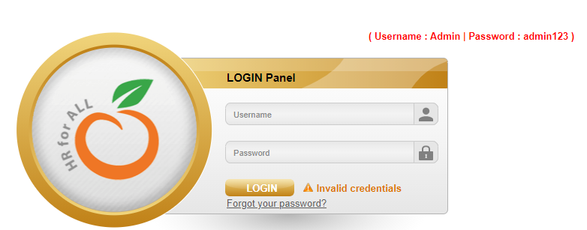
Web Element In Selenium: XPATH, CSS_SELECTOR

Slide 9
Web Element In Selenium:LINK_TEXT
from selenium import webdriver
from selenium.webdriver.common.by import By
import time
driver = webdriver.Chrome(executable_path="C:\\Users\\Fahad Ahmed\\PycharmProjects\\SeleniumProject01\\drivers\\chromedriver.exe")
driver.get("https://opensource-demo.orangehrmlive.com/")
print(driver.current_url)
time.sleep(2)
driver.find_element(By.LINK_TEXT,"Forgot your password?").click()
print("Click on: Forgot your password?\n")
driver.close()

Slide 10
Web Element In Selenium: PARTIAL_LINK_TEXT
from selenium import webdriver
from selenium.webdriver.common.by import By
import time
driver = webdriver.Chrome(executable_path="C:\\Users\\Fahad Ahmed\\PycharmProjects\\SeleniumProject01\\drivers\\chromedriver.exe")
driver.get("https://opensource-demo.orangehrmlive.com/")
print(driver.current_url)
time.sleep(2)
driver.find_element(By.PARTIAL_LINK_TEXT,"Forgot your").click()
print("Click on: Forgot your password?\n")
time.sleep(2)
driver.close()

Slide 11
Web Element In Selenium: TAG_NAME
from selenium import webdriver
from selenium.webdriver.common.by import By
import time
driver = webdriver.Chrome(executable_path="C:\\Users\\Fahad Ahmed\\PycharmProjects\\SeleniumProject01\\drivers\\chromedriver.exe")
driver.get("https://opensource-demo.orangehrmlive.com/")
time.sleep(2)
driver.find_element(By.TAG_NAME,"a").click()
print(driver.current_url)
time.sleep(2)
driver.close()

Slide 12
Web Element In Selenium: screenshot
from selenium import webdriver
from selenium.webdriver.common.by import By
import time
from PIL import Image
driver = webdriver.Chrome(executable_path="C:\\Users\\Fahad Ahmed\\PycharmProjects\\SeleniumProject01\\drivers\\chromedriver.exe")
driver.get("https://opensource-demo.orangehrmlive.com/")
time.sleep(2)
driver.save_screenshot("image.png")
# Loading the image
image = Image.open("image.png")
# Showing the iamge
image.show()
driver.close()

Slide 13
Web Element In Selenium: screenshot
from selenium import webdriver
from selenium.webdriver.common.by import By
import time
from PIL import Image
driver = webdriver.Chrome(executable_path="C:\\Users\\Fahad Ahmed\\PycharmProjects\\SeleniumProject01\\drivers\\chromedriver.exe")
driver.get("https://opensource-demo.orangehrmlive.com/")
element = driver.find_element_by_id("divLogo");
location = element.location;
size = element.size;
driver.save_screenshot("logoImage.png");
# crop image
x = location['x'];
y = location['y'];
width = location['x']+size['width'];
height = location['y']+size['height'];
im = Image.open('logoImage.png')
im = im.crop((int(x), int(y), int(width), int(height)))
im.save('logo-section-Image.png')
driver.quit()

Slide 14
Web Element In Selenium: Report Generation
from selenium import webdriver
import unittest
import HTMLTestRunner ## pip install html-testRunner in command line
from selenium.webdriver.common.by import By
class TestReport(unittest.TestCase):
@classmethod
def setUpClass(cls):
cls.driver = webdriver.Chrome(executable_path="C:\\Users\\Fahad Ahmed\\PycharmProjects\\SeleniumProject01\\drivers\\chromedriver.exe")
cls.driver.implicitly_wait(2)
def test_search_one(self):
self.driver.get("https://opensource-demo.orangehrmlive.com/")
self.driver.find_element(By.LINK_TEXT,"Forgot your password?").click()
def test_search_two(self):
self.driver.get("https://opensource-demo.orangehrmlive.com/")
self.driver.find_element(By.LINK_TEXT, "Forgot your").click()
@classmethod
def tearDownClass(cls):
cls.driver.close()
cls.driver.quit()
print("Test Completed")
if __name__ == '__main__':
unittest.main(testRunner=HTMLTestRunner.HTMLTestRunner(output='C:/Users/Fahad Ahmed/PycharmProjects/SeleniumProject01/Reports'))

Slide 15

Thanks to All

